Slide 1
July 2025
MASTERING THE ART OF CHANGE MANAGEMENT
WHY ADAPABILITY IS NON-NEGOTIABLE
Ad logo here

Slide 2
PROJECT MANAGEMENT MASTERCLASS
PRESENTED BY:
GORD AFFUL,pmp

Slide 3

GORD-AFFUL, PMP
AREAS OF INTEREST
PROJECT MANAGEMENT
CHANGE MANAGEMENT
PUBLIC/MOTIVATIONAL SPEAKING
TALENT NURTURING
EDUCATIONAL NEUROSCIENCE
LEADERSHIP
OIL & GAS MANAGEMENT
ENTREPRENEURSHIP
HEALTH & SAFETY

Slide 4
PRESENTATION PRECIS
INTRODUCTION TO CHANGE MANAGEMENT
CASE STUDY: SOKOBAN WOOD VILLAGE
WHY STAY ADAPTABLE? WHY EMBRACE CHANGE?
CHANGE MANAGEMENT MODELS
THE UPPRA 5 STAGE MODEL FOR CHANGE MANAGEMENT
WORKSHOP GROUP TASK
QUESTIONS & ANSWERS

Slide 5
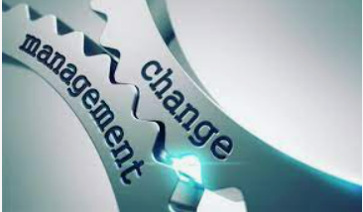
UNDERSTANDING CHANGE
CHANGE IS INEXORABLY CONSTANT
CHANGE WILL ALWAYS BE PART OF PROJECTS AND THE BUSINESS
CHANGE COULD EMANATE FROM INTERNAL INFLUENCES OR EXTERNAL SOURCES
ENABLING CHANGE IS COMPLEX; A DIFFICULT PROPOSITION
EFFECTIVE CHANGE MANAGEMENT ESPOUSES MORE OF A MOTIVATIONAL STRATEGY THAN A COERCIVE ONE
CHANGE MANAGEMENT IS PARTNERSHIP; IT’S NEGOTIATION
IT IS VITALLY IMPORTANT FOR ORGANISATIONS TO STAY ADAPTABLE AND MASTER CHANGE ENABLEMENT
‘CHANGE MANAGEMENT IS NOT THE SAME AS CHANGE CONTROL’

Slide 6

TASK 1
A SENIOR EXECUTIVE APPROACHED YOU AND ASKED :
WHAT BENEFITS DO WE GAIN FROM EMBRACING CHANGE AND BECOMING ADAPTABLE?
WHAT WOULD BE YOUR RESPONSE?

Slide 7
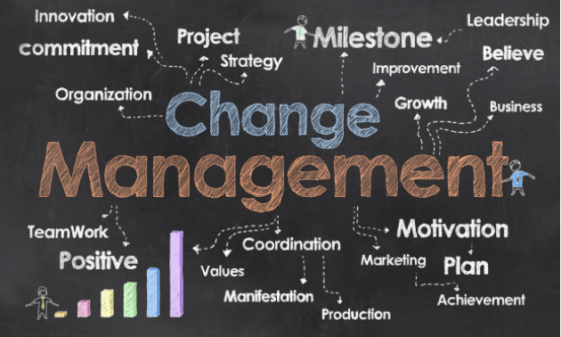
WHAT IS CHANGE MANAGEMENT?
IT IS A CCS APPROACH
IT IS A COMPREHENSIVE, CYCLIC, AND STRUCTURED APPROACH FOR TRANSITIONING INDIVIDUALS, GROUPS OR AN ORGANISATION FROM A CURRENT STATE TO A FUTURE STATE IN WHICH THEY REALISE DESIRED RESULTS ( PMBOK 2021:58)

Slide 8
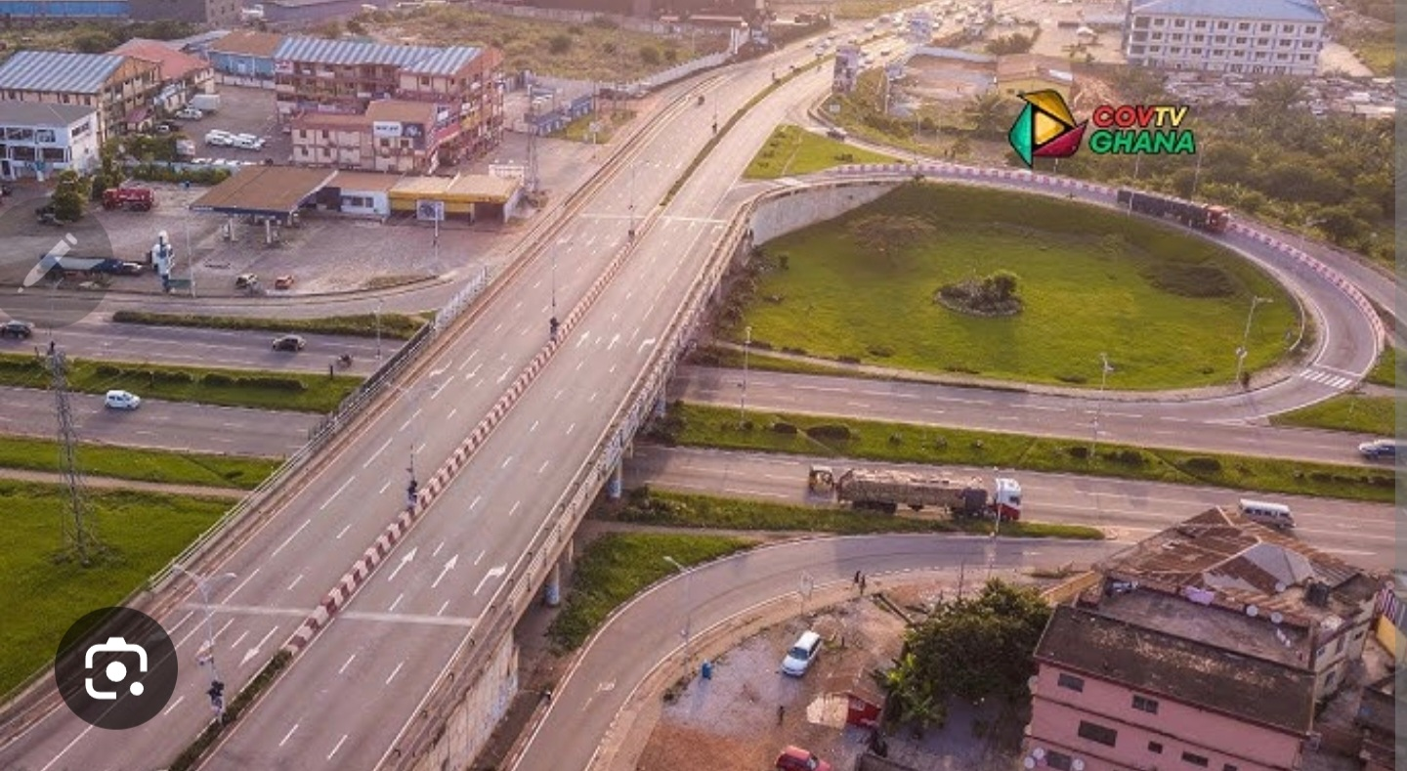
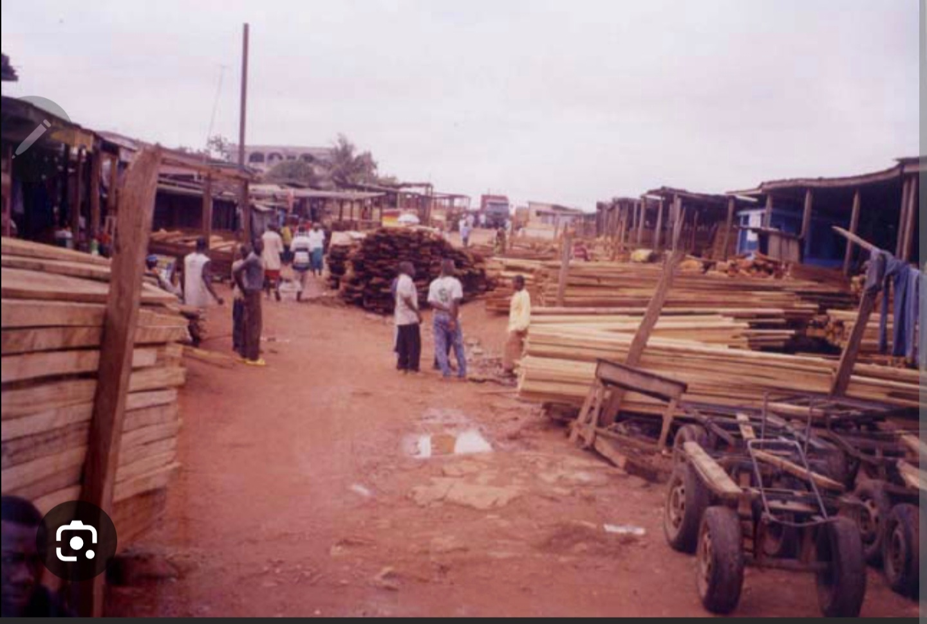
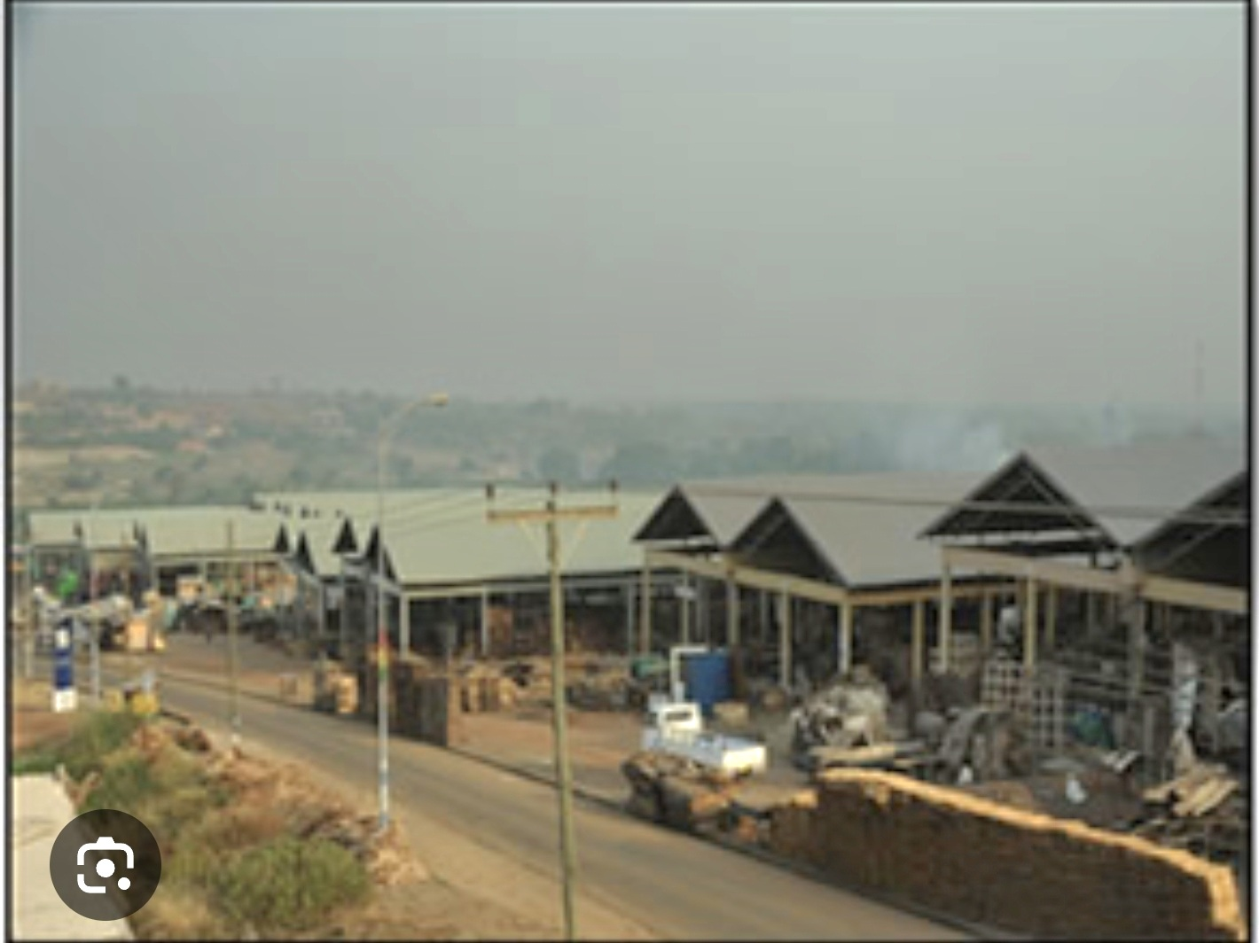
CASE STUDY
SOKOBAN WOOD VILLAGE
( ANLOGA WOOD MARKET TO SOKOBAN WOOD VILLAGE,PART OF THE KSI ROADS & URBAN DEV’T PJ. )
LOCATION: SOKOBAN, ASHANTI REGION
DATE: 2008

Slide 9
SOKOBAN WOOD VILLAGE
KEY PRIMARY STAKEHOLDERS
GOVERNMENT OF GHANA (INAUGURATED BY FORMER PRES. J. A KUFFOUR)
AGENCE FRANCAISE DE DEVELOPPEMENT (AFD)---MAIN SPONSOR
URBAN ROADS
KMA
CARPENTERS’ UNION ASSOCIATION
LUMBER SEELERS’ ASSOCIATION
GPRTU
FOOD VENDORS
HARDWARE SELLERS’ ASSOCIATION
MANHYIA PALACE
SOKOBAN PALACE
KAASE PALACE

Slide 10
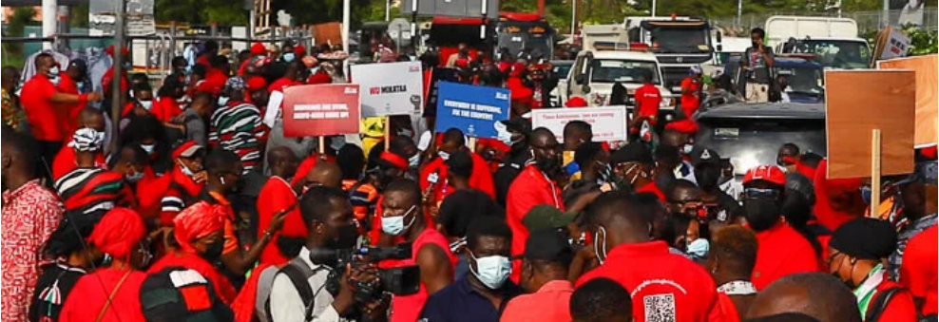
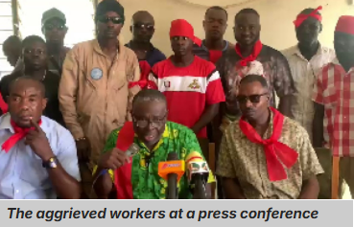
WHY PEOPLE FIGHT CHANGE?
ONE MAIN REASON: FEAR
  FEAR OF UNCERTAINTY
  FEAR OF LOSS ( LIBERTY OR GAIN)

Slide 11
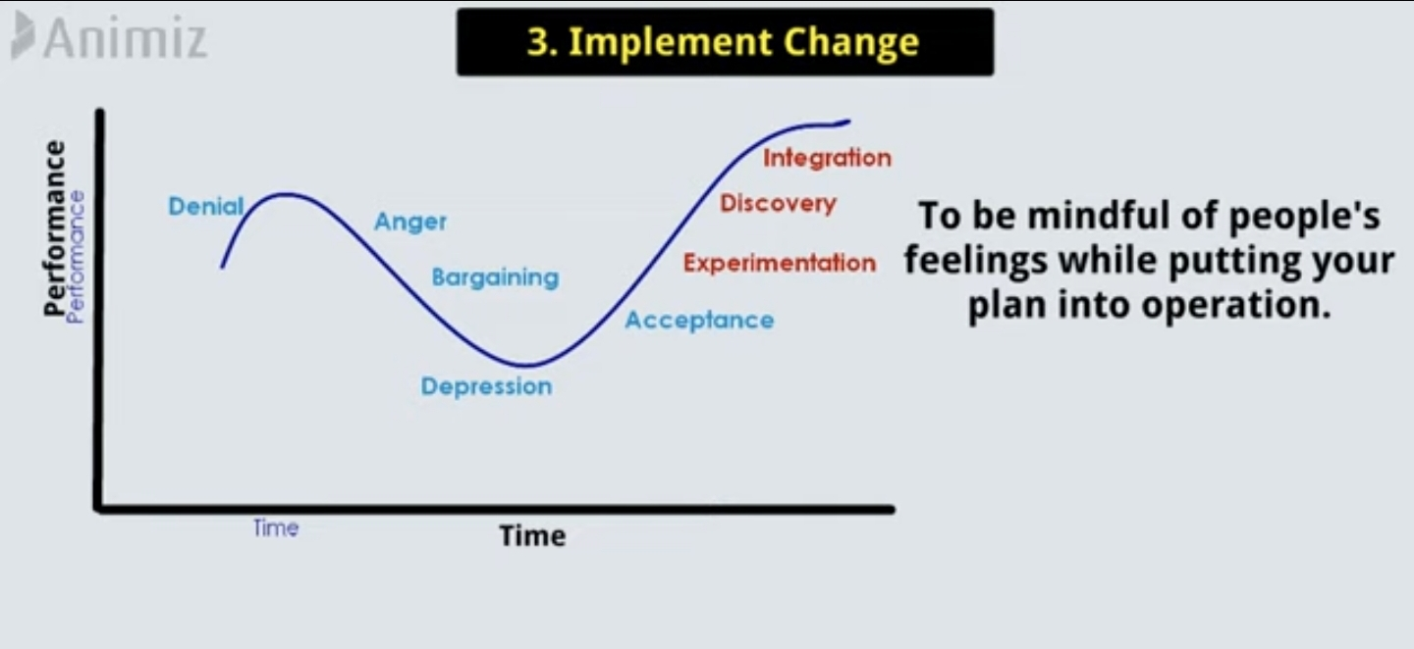
KUBLER-ROSS CHANGE CURVE

Slide 12
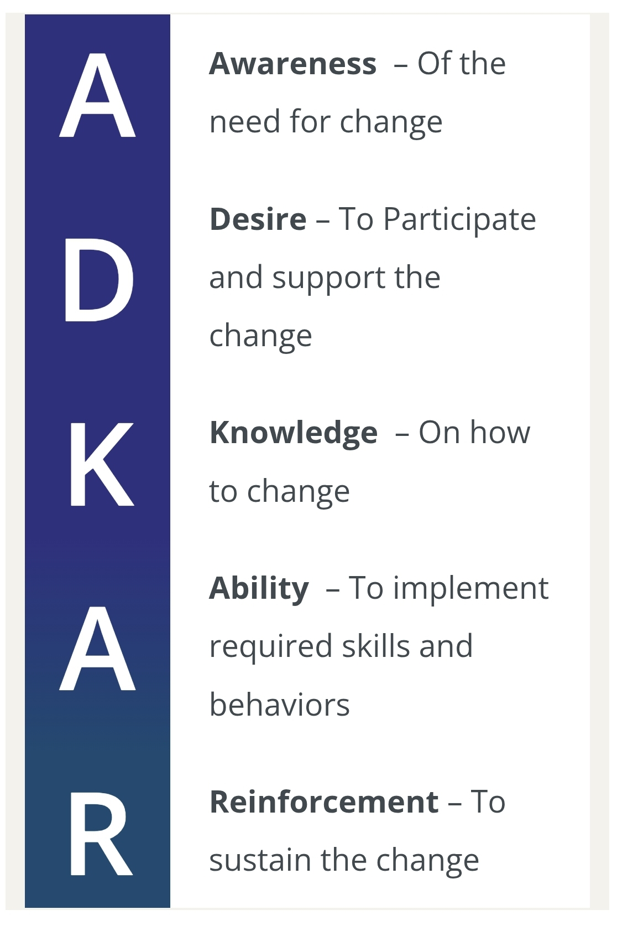
CHANGE MODELS
ADKAR MODEL
VIRGINIA SATIR CHANGE MODEL
THE 8 - STEP PROCESS FOR LEADING CHANGE
LEWIN’S CHANGE MODEL
UPPRA MODEL (THE GORDISH TREE MODEL)

Slide 13

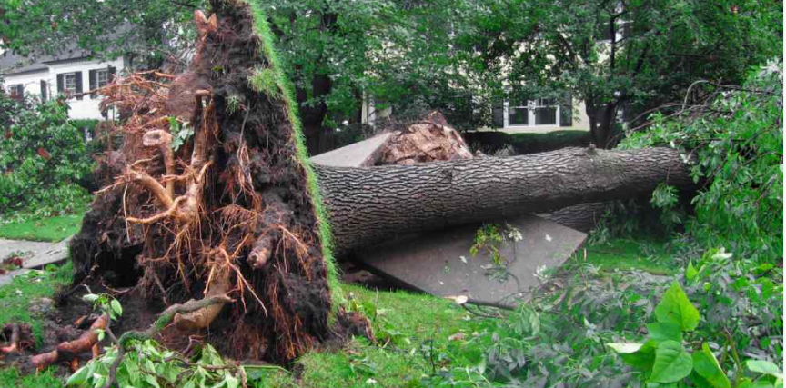
HOW DO I FOLLOW THE 8 STEPS FROM JOHN KOTTER?
UPPRA 5- STAGE MODEL FOR CHANGE MANAGEMENT
UPPRA CHANGE MODEL

Slide 14
THE 5 STAGE APPROACH
(UPPRA CHANGE MODEL)
UPROOTING:
  Create urgency; communicate need for change
  Secure support
  Study the roots ( understand readiness, resiliency, knowledge, ability, obstacles etc)
  Communicate future state (vision)
PLANTING:
  Plan change management
  Address bottlenecks
  Implement change
  Make necessary adjustments
:
PRUNING:
  Provide further support and guidance
  Continue to motivate
  Build trust and empower
RIPENING:
  Push for small wins (success stories)
  Communicate small wins
  Build on small wins
  Stay Consistent
ANCHORING:
  Consolidate change
  Incorporate change into organizational DNA

Slide 15
SOKOBAN WOOD VILLAGE: 10 KEY LESSONS
CHANGE MANAGEMENT IS A TOUGH JOURNEY
RESILIENCY IS A VIRTUE
ADAPTABILITY IS GOLDEN
EXECUTIVE SUPPORT IS CRUCIAL
STAKEHOLDER ENGAGEMENT IS VITALLY IMPORTANT
THE FUTURE STATE SHOULD BE BETTER THAN THE CURRENT STATE
MOTIVATION OVER COERCION
PROJECT MANAGEMENT IS A POWERFUL TOOL FOR SUCCESS
THINK SUSTAINABILITY FROM THE BEGINNING
CHANGE CHAMPIONS SUSTAIN CHANGE

Slide 16
TASK 2
AS CHANGE MANAGEMENT EXPERTS, YOU HAVE BEEN CONSULTED TO ASSIST MINISTRY EDUCATION INCORPORATE PROJECT MANAGEMENT PRACTICES INTO THEIR MANAGEMENT SYSTEM FOR IMPROVED EFFICIENCY AND GROWTH
---------------------------------------------------------------------------------------------------------------------
BRIEFLY EXPLAIN TO THE BOARD THE KEY STEPS WOULD YOU GO THROUGH TO ENSURE SUCCESSFUL IMPLEMENTATION OF THIS CHANGE

Slide 17

WHAT ARE YOUR MAJOR TAKEAWAYS?

Slide 18
KEY TAKEAWAYS
CHANGE IS INEVITABLE, BUT CHANGE IS MANAGEABLE
CHANGE MANAGEMENT IS A MIND GAME, NOT A MUSCLE GAME----MOTIVATION OVER COERCION
ORGANISATIONS SHOULD EMBRACE ADAPTABILITY & RESILIENCY
PMs SHOULD POSSESS CHANGE MANAGEMENT SKILLS, AND NOT JUST ABILITY---SKILL OVER ABILITY
KEY ELEMENTS THAT ENABLE CHANGE: UNDERSTANDING, MOTIVATION, SUPPORT, STAKEHOLDER ENGAGEMENT, RESILIENCY, PROJECT MANAGEMENT & SUSTAINABILITY
USECRAPS IS A SIMPLE, EFFECTIVE MODEL THAT CAN BE ESPOUSED TO LEAD AND ENABLE CHANGE IN AN ORGANISATION

Slide 19
MY NAME IS GORD-AFFUL
INSTAGRAM: gordafful123
LINKEDIN: GORD-AFFUL,PMP
YOU TUBE: GORD AFFUL,PMP,P2
LET’S DO GREAT THINGS TOGETHER!!
CHEERS!

